Slide 1

Hangman
By Christopher Douglas

Slide 2
What is the game
Hangman is a classic word-guessing game where the player must guess a hidden word one letter at a time before running out of guesses.

Slide 3

Methods
I will use random, while loop, input, string, list, set, and function

Slide 4
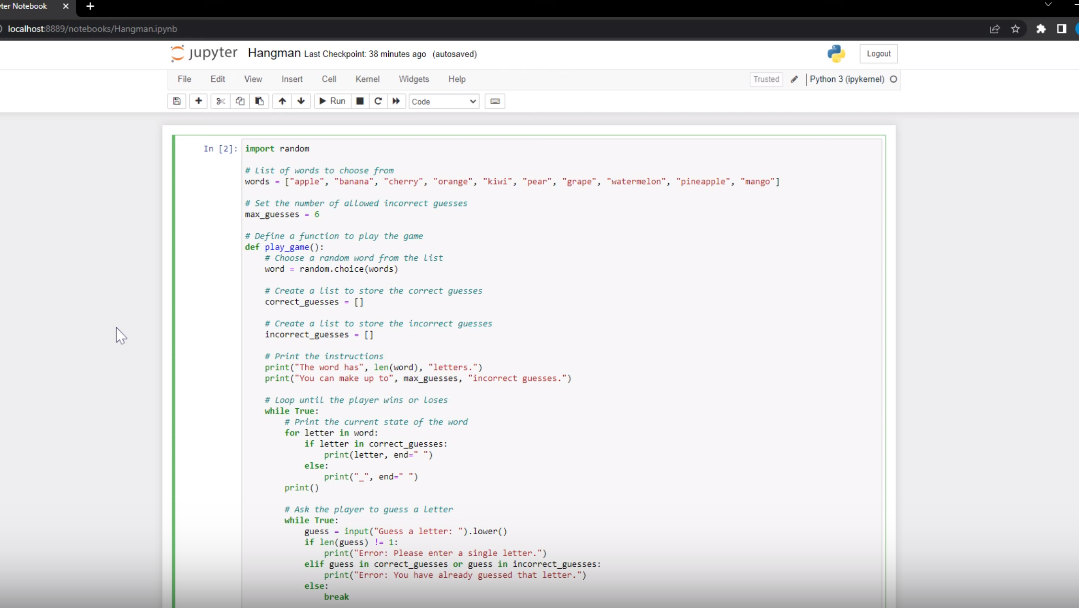
Video

Slide 5
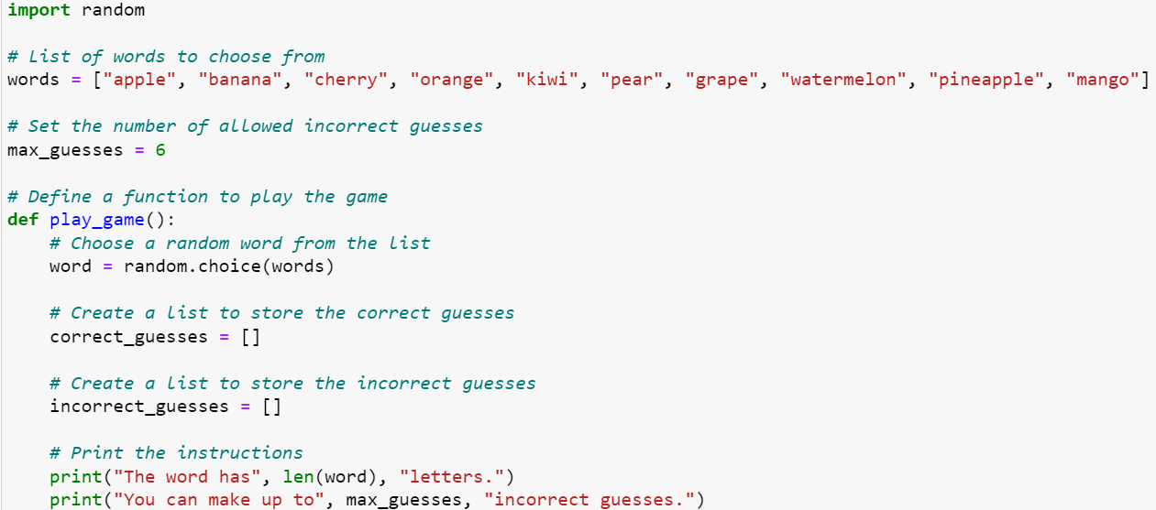
Guesses

Slide 6
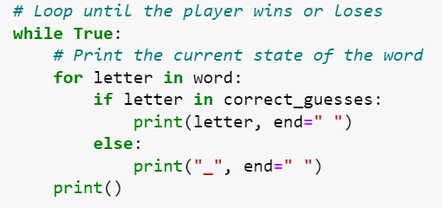
Game State

Slide 7
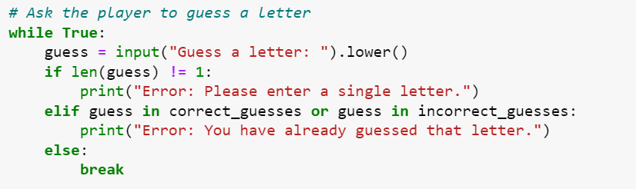
Guessing A Letter

Slide 8
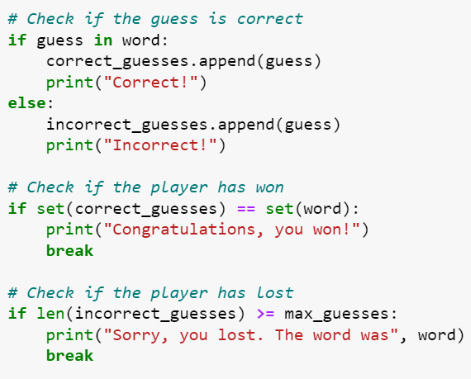
Checks

Slide 9
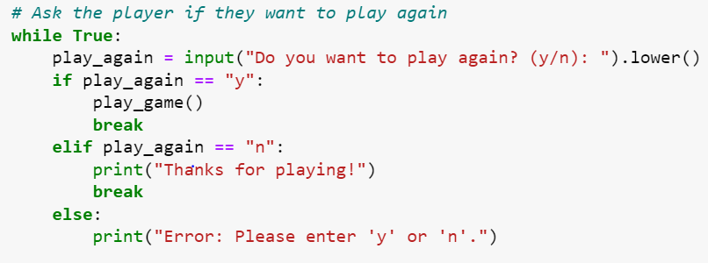
Pay Again?

Slide 10
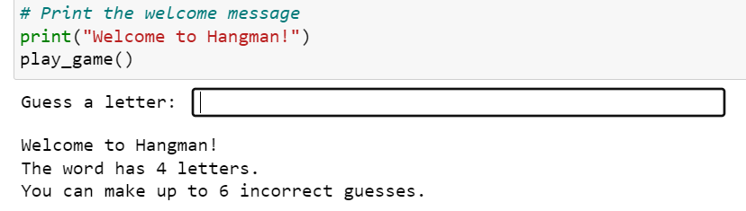
Welcome

Slide 11
Thank you

